Slide 1
Slide 1 — Project definition
Motivation
What we compare
Clinical notes embed follow-up instructions in free text.
Goal: convert follow-up items into machine-readable JSON
so completion can be checked downstream (EHR / workflows).
• BioBERT pipeline: NER(ACT/TIME) + learned linking head + dateparser
• LLaMA fine-tune (LoRA): direct JSON extraction baseline
• ChatGPT zero-shot: prompt-only baseline
Key metrics
• Action span F1, Time span F1
• End-to-end Action+Date F1
• Date MAE (days) on matched actions
Task (input → output)
Input: outpatient visit note text (includes visit date).
Output: list of scheduled follow-ups:
[{ action, period_date }]
Internally: extract period text (“two weeks”) span then normalize to date.
Datasets
Synthetic diverse doctor visit notes for closed set action of 28 actions.

Slide 2
Problem
Why extract follow-up instructions?
Clinical notes are rich—but not machine-readable.
Joint IE task
What becomes possible
Why it is hard
Automatically check if patients completed ordered follow-ups (via EHR queries)
Trigger reminders / outreach for overdue items
Support triage and care coordination
Reduce manual chart review and quality monitoring effort
“MRI in 2 weeks”->
{"action": "MRI", "period_date": "2025-03-08"}
Multiple actions and multiple time phrases in the same note
Past history vs future plan time expressions
Action and time can be non-adjacent (time-first, split lines, parentheses)
Linking ambiguity when 2 actions + 2 time phrases appear together

Slide 3
Dataset
Goal: generate realistic, diverse outpatient notes with controlled ground truth
Generation technique
Skeleton-first: sample specialty/topic/styles, visit date, actions, and deterministic timing phrase templates.
LLM writes the narrative note; plan section uses a random header and includes exactly the allowed scheduled items.
Deterministic period_date label computed with dateparser using RELATIVE_BASE = visit date .
What we generated & labeled
2,000 notes across 5 specialties (Orthopedic, Cardio/Pulm, GI, Neuro, General).
Each note contains a visit date and optionally a plan header; 0–2 scheduled items per note.
Ground truth per scheduled item: action (closed set), period_text, computed period_date, plus character spans (action/time) for BIO training.

Slide 4
Synthetic Dataset Generation
To ensure the downstream NLP models (BioBERT, Llama) generalize effectively to real-world clinical noise, the dataset generation process was engineered to maximize variance across four key axes: Clinical Domain, Linguistic Style, Temporal Expression, and Structural Formatting.
The goal was to move beyond simple template-filling and create a dataset that mimics the "long tail" of irregularity found in genuine Electronic Health Records (EHRs).

Slide 5
Clinical Domain Diversity
To prevent the model from overfitting to specific medical vocabularies, we implemented a broad coverage of clinical scenarios.
Breadth of Specialties: The generator rotates through 5 distinct medical domains: Orthopedics, Cardiovascular/Pulmonary, Gastroenterology, Neurology, and General Medicine.
Condition Granularity: Each specialty draws from a pool of specific pathologies (e.g., ACL Tear vs. Lumbar Herniated Disc in Orthopedics; Atrial Fibrillation vs. COPD in Cardio). This ensures the model encounters diverse symptom descriptions and medical reasoning.
Action Variety: The target labels (actions) range from imaging (MRI, CT Scan) to procedures (Endoscopy, Joint Injection) and consultations (Physical Therapy, GI Consult).

Slide 6
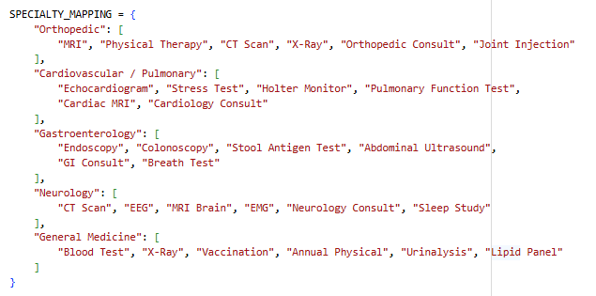
Dataset
Generating diverse dataset

Slide 7
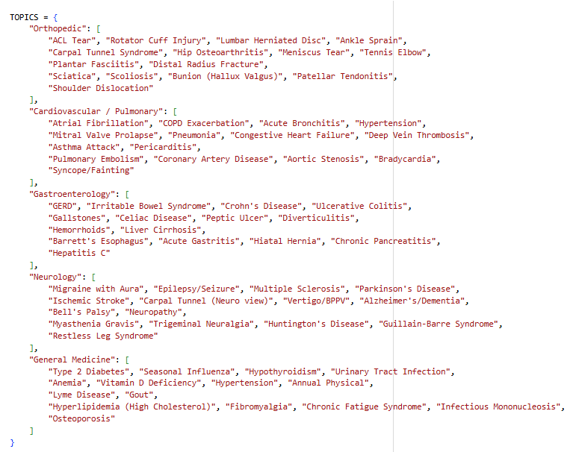
Dataset

Slide 8
Linguistic Diversity (Stylistic Variance)
A major innovation in this pipeline is the STYLE_FEATURES_DICT, which randomly injects stylistic constraints into the LLM prompt. This prevents the "synthetic distinctness" often seen in AI-generated text.
Narrative Voice: Shifts between First Person ("I recommend...") and Third Person/Passive ("Patient to return...").
Tone & Persona: Simulates different clinician archetypes, from the Educator (who explains the 'why') to the Burnout/Hasty clinician (telegraphic, minimum viable documentation).
Simulated Noise:
  Typos: Simulated fast-typing errors (e.g., "pateint").
  Dictation Artifacts: Run-on sentences and missing punctuation typical of voice-to-text software.
  Shorthand: Heavy use of clinical abbreviations ("c/o CP, SOB" vs. "complains of chest pain, shortness of breath").

Slide 9
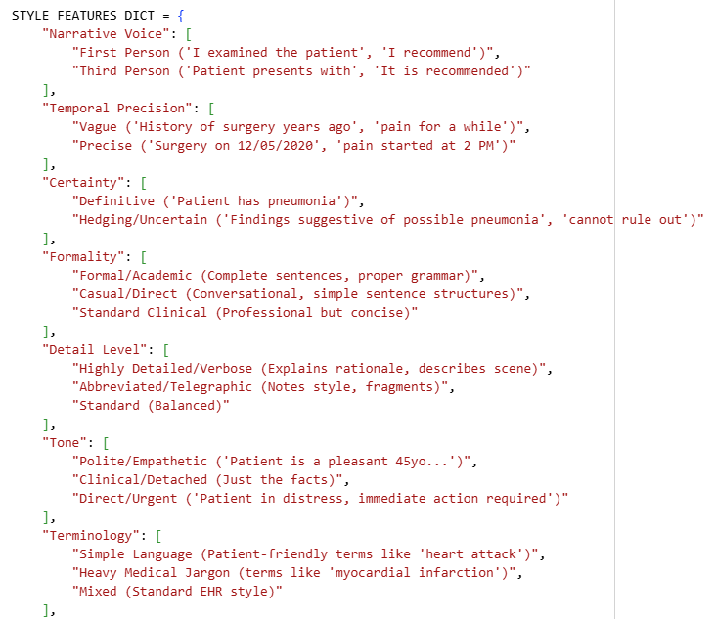
Dataset
Diverse note style

Slide 10
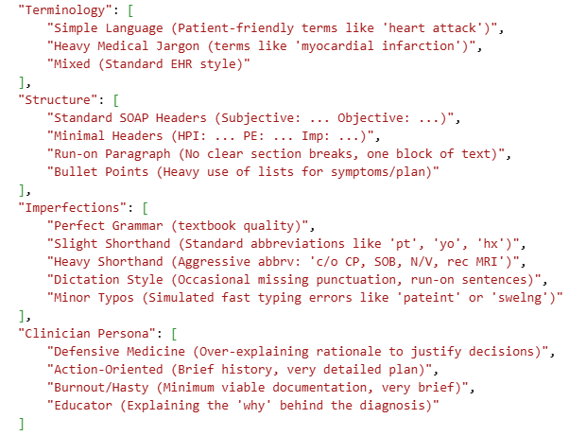
Dataset
Diverse note style

Slide 11
Temporal Expression Diversity
Temporal Expression Diversity
Since the core task is Time Extraction, the dataset rigorously varies how time is encoded. The model must learn semantic equivalence across these formats:
Units & Numerals: Random mixing of digits vs. words ("7 days" vs. "seven days") and unit variations ("wks", "weeks", "mo").
Absolute vs. Relative: While the output is normalized dates, the input text varies between relative durations ("in 2 weeks") and fuzzy approximations ("in about a week“)
Phrasing Templates: We utilize 10+ weighted templates to vary the lead-in phrase:
  Standard: "Return in 2 weeks"
  Passive: "Follow up in 2 weeks"
  Noun-Phrase: "2-week follow-up"
  Shorthand: "2wk f/u", "in ~2wks"

Slide 12
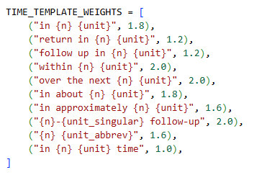
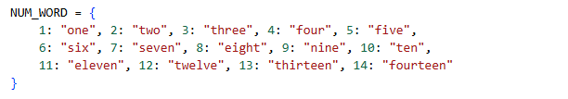
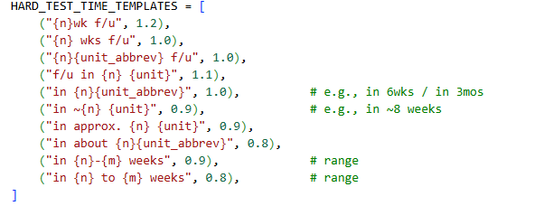
Temporal Expression Diversity

Slide 13
Structural & Layout Diversity
To prevent the model from learning positional heuristics (e.g., "the date is always at the end of the line"), we strictly controlled the structural layout via PLAN_VARIANTS.
Format A/B (Inline): ACTION - TIME vs TIME: ACTION (Testing attention direction).
Format C (Narrative): The action and time are embedded in a full sentence. ("Plan: We will schedule an MRI in 2 weeks time.")
Format D (Parenthetical): ACTION (TIME) — A common shorthand pattern.
Format E (Grouped): Diagnostics: ACTION (TIME); ACTION (TIME) — Testing the ability to parse list delimiters.
Format F (Split Line): The action and time are separated by newlines, forcing the model to aggregate information across line breaks.

Slide 14
Doctor Visit Note Example
Date of Visit: 2024-03-26
Patient is a pleasant 45-year-old male presenting with weakness on the right side and difficulty speaking, which began approximately 2 weeks ago. He reports that these symptoms intensified over the past few days. Neurological examination reveals right-sided hemiparesis and expressive aphasia. His past medical history is significant for hypertension, which has been well controlled. A prior CT scan, performed during his last visit, was negative for acute changes.
After discussing his symptoms, I believe he has experienced an ischemic stroke. I emphasized the importance of immediate management to prevent further complications, especially since he has been feeling progressively worse and may need a more comprehensive evaluation.
INSTRUCTIONS:
I recommend an MRI Brain. This will be scheduled in 12 days. Additionally, we should conduct a Sleep Study to assess any potential underlying sleep disorders. This will take place over the next three days. I advised the patient to monitor his symptoms closely and to seek emergency care if not improved in 48 hours or if he experiences any worsening of his condition. We will follow up on the results of these evaluations at his next appointment.

Slide 15
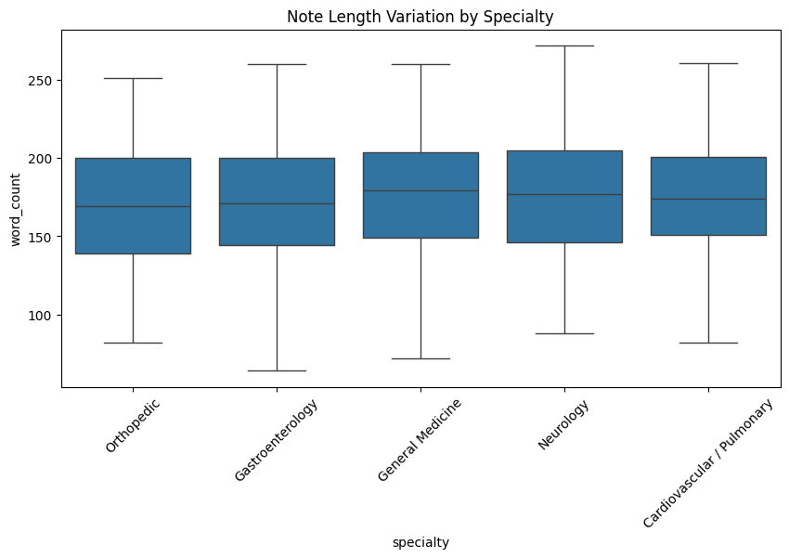
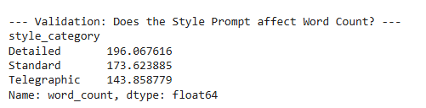
Dataset
Style Prompt Affect
Note Length Per Specialty

Slide 16
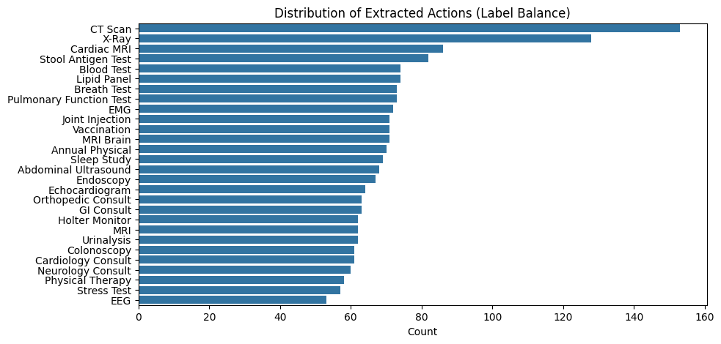
Actions Distribution

Slide 17
Methods
Approaches compared
Structured pipeline vs generative baselines.
🧪 Synthetic
notes
🧬 BioBERT
encoder
🧬 NER BIO TAG
Actions and times
🔗 Linker
(action↔time)
📅 Date
normalize
🧾 JSON
output
Baseline B — Fine-tuned LLaMA (generative)
Baseline C — Zero-shot ChatGPT (generative)
Prompted to output JSON directly
Trained on synthetic dataset with closed action set in prompt
Main risk: date arithmetic & formatting errors
No fine-tuning; prompt asks for strict JSON only
Strong at finding actions/time phrases
Still makes relative→absolute date mistakes

Slide 18
Head A: Named Entity Recognition (NER)
This component is responsible for identifying the actions and dates
Scheme: We employ a BIO Tagging Scheme with 5 classes: O (Outside), B-ACT (Begin Action), I-ACT (Inside Action), B-TIME (Begin Time), and I-TIME (Inside Time).
Class Imbalance Handling: To prevent the model from bias toward the majority class (O), we apply weighted Cross-Entropy Loss, assigning a 10x penalty for missing valid entity tokens compared to background tokens.

Slide 19
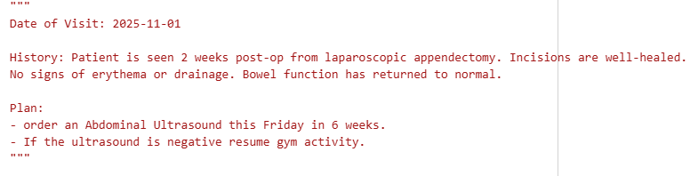
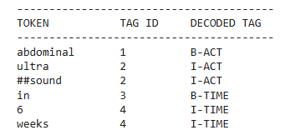
Head A: BIO TAGGING

Slide 20
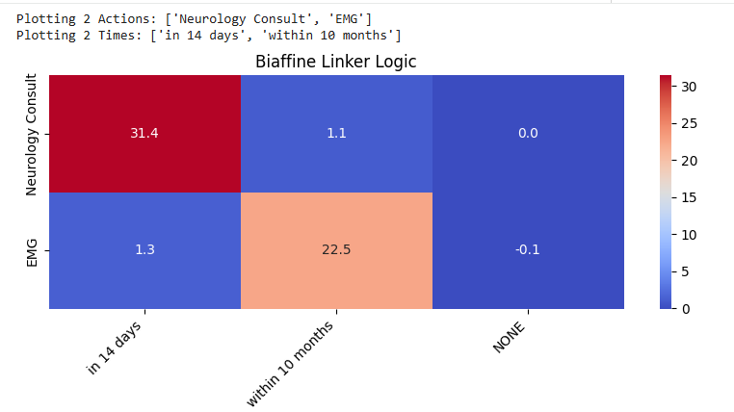
Head B: Biaffine Linker
ASSESSMENT & PLAN:
• Carpal tunnel syndrome likely contributing to patient's symptoms.
• Neurology Consult (in 14 days) to further evaluate and discuss potential interventions.
• EMG (within 10 months) to assess the severity of median nerve involvement and confirm diagnosis.

Slide 21
Training Methodology
The model is trained using a Joint Loss function that optimizes both tasks simultaneously:
L_{total} = L_{NER} + α * L_{Linking}
(Where α =1.0 balances the importance of both tasks).
Early Stopping: To prevent overfitting to the synthetic data patterns, we monitor validation loss with a patience of 4 epochs. (In our experiments, the model converged to optimal performance at Epoch 7).

Slide 22
LLaMA baseline-direct JSON extraction
[
{"action": "MRI Brain", "period_date": "2025-02-15"}
]
system_prompt = """You are an expert clinical information extraction system.
Task:
Extract ONLY scheduled follow-up items from the clinical note (tests/labs/imaging/referrals/therapy explicitly planned for the future).
Ignore history/past tests/symptom duration.
Return ONLY valid JSON.
""“user_prompt = f"""Rules:
- Output must be a JSON array (possibly empty).
- Each item must be a scheduled follow-up item from the note (not history).
- action must be EXACTLY one of the allowed actions below (no new actions).
- period_date must be computed relative to the visit date line in the note (YYYY-MM-DD).
{"- period_text must be copied verbatim from the note.\n" if LLAMA_TARGET_MODE != "date_only" else ""}
- If no scheduled items: return [].
- Output JSON only (no markdown, no extra text).
Allowed actions:
{allowed_actions}
Clinical note: {note}"""

Slide 23
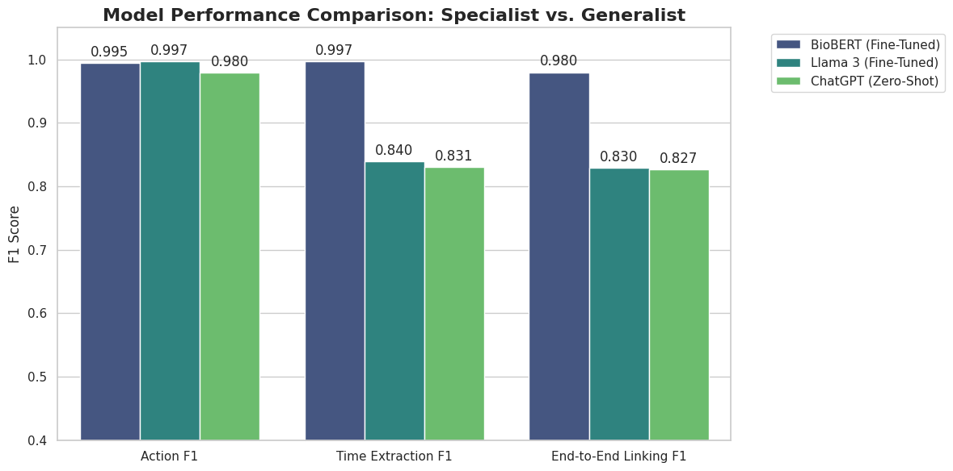
Comparing metrics

Slide 24
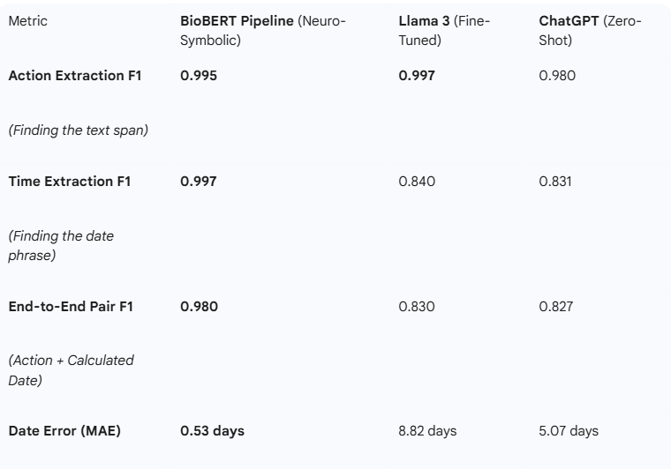
Model Performance Comparison Table

Slide 25
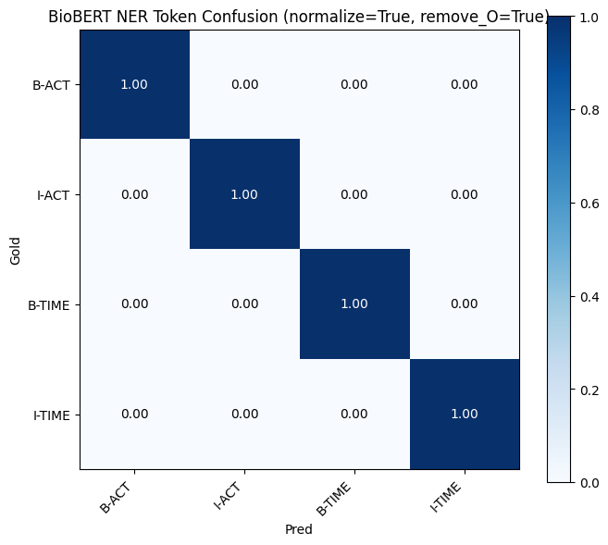
BioBERT Confusion Matrix

Slide 26
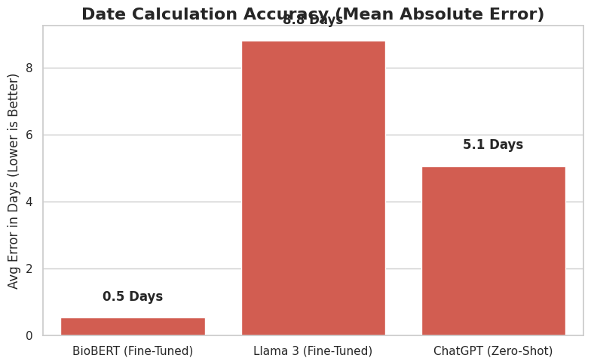
Date Calculation Accuracy (Mean Absolute Error)

Slide 27
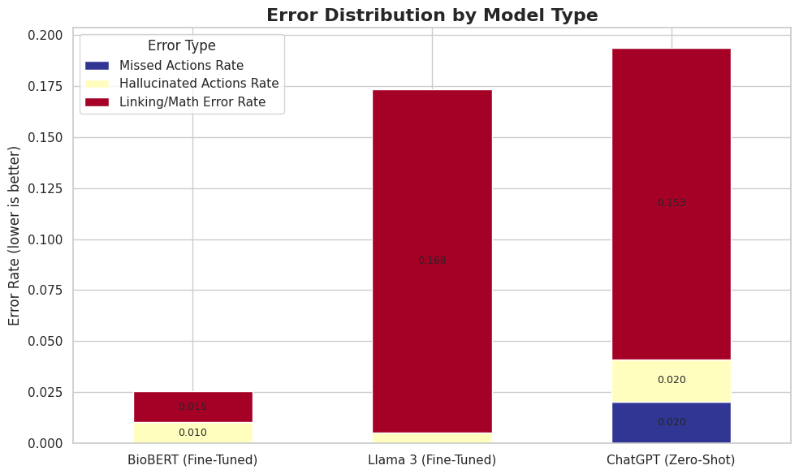
Error Distribution by Model Type

Slide 28
Conclusion
Did we achieve the goal?
Limitations
• Synthetic data is still cleaner than real EHR notes.
Yes. BioBERT pipeline reliably outputs follow-up actions with normalized dates (≈0.98 F1)
Key takeaways
Future work
• LLMs can extract actions, but direct date generation is brittle.
• Extracting period_text as evidence + dateparser improves consistency.
• Extend the problem beyond 28 actions
• Allow more actions per note
• Evaluate pipeline on real-note benchmark

